Slide 1

Giving a Presentation
How to give a good presentation
How to give a good peer review feedback
School of Computing and Information
Department of Computer Science

Slide 2
Presentation Logistics
Next 10 weeks: CS 1900 internship presentations
Final week: CS 1950 research presentations
Complete the Doodle poll that will open at 8:00 PM
All talks must be submitted to courseweb by Thursday midnight the day before your presentation
Preferred format: PDF
Alternative format: Powerpoint, Keynote
Please put a cover page with title, name, and organization (So that reviewer knows who you are and where you worked)
Please number your slides!

Slide 3
On the day of your presentation …
Max 9 students per day / 5 minutes for each student
I will cut you off if you go over 5 minutes
I will hold up a sign when you only have 1 minute remaining
Please DO NOT be late to class!
Presenters please come 5 minutes early to set up
Designated front row for presenters
Presenters will sit in the order of their presentations
Slides will be stored in order on in-class computer
At end of talk, please close your slides and open next slides

Slide 4
Peer Review Logistics
Please use the review form on course website
Submit review by Sunday midnight
Reviews are to submitted through courseweb
Review assignment table to be posted soon
Assignments done using a Reviewer ID for anonymity
Each row has ID followed by 5 people you need to review If row is: “23” “John” “Jane” “Ben” “Mary” “Alex”, reviewer 23 is expected to review these 5 people
Your reviewer ID will be emailed to you individually

Slide 5
Peer Review What Not To Do
Don’t be lax but also don’t be harsh
I expect the majority of students to get 4 out of 5
Don’t judge presenter on the work done
Judge presenter on how the work was presented
A peer review is not about …
Humiliating your peer
Demonstrating your vast sea of knowledge
Complaining about how much time was wasted listening
Using wording that triggers an emotional response

Slide 6
Peer Review What To Do
Take care to write summary of talk
Shows your peer that you actually paid attention
Support your overall merit score with data
Your subcategory scores should support your overall score
Your comments should give further justification
Be constructive
Positive comments are just as valuable as negative ones
Remember, the goal is to help your peer

Slide 7
Peer Review Requirements
To be considered complete:
Review must contain summary of talk
Review must contain scores for all categories
Review must contain comments that support the score (Preferably both positive and negative feedback
Otherwise, your review will be marked as incomplete (0) even if you submitted

Slide 8
Now let’s talk about giving a good talk

Slide 9
But first, some slide design fails

Slide 10
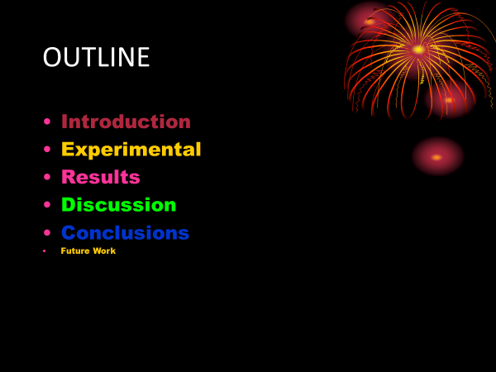
Admire my beautiful slide

Slide 11
Admire my beautiful slide
A slide is not a work of art – curb your enthusiasm
Fonts, colors, and style should be consistent
If not, the difference should convey a meaning
Also remember, a portion of population is color blind
By the way, was that outline slide really necessary?
Most talks are structured that way – no information content

Slide 12
Read my code

Slide 13
Read my code
Hate to break it to you but …
Nobody wants to read your code (if avoidable)
If you really feel the need …
At least explain at a high level what the code is trying to do
Focus audience attention at the part that is interesting

Slide 14
I am a math whiz

Slide 15
I am a math whiz
Well guess what. Many are not.
Translate math to plain English whenever you can

Slide 16
Just read my text
Proof sketch:

Slide 17
Just read my text
Then why am I listening to you?
Having too much to read can interfere with listening
Did you know? Reading and listening exercise same part of brain

Slide 18
Content and delivery are just as (perhaps more) important

Slide 19
Issues with Content and Delivery
Issues with content:
Why should we care about the problem?
How will the results be useful in practice?
Had no idea where talk was going!
Missing context to understand problem setup
Issues with delivery:
Lack of eye contact
Lecturing to the board/laptop, not the audience
Speaks too quickly / too slowly
Overruns allotted time

Slide 20

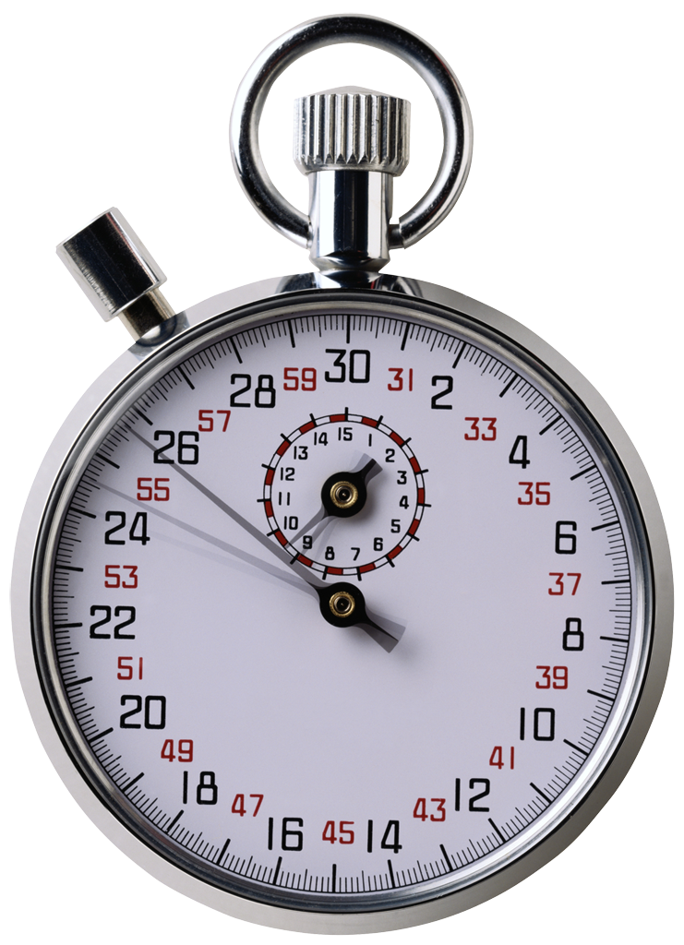
Structure your talk based on your audience and the time that you have
Your audience: Generally smart individuals
Computer Scientists? Yes
Knowledgeable about your area? Maybe
Knowledgeable about your problem? Probably not
Time is usually limited
Invited talk: < 1 hour
Conference talk: 20 minutes or so
Elevator talk: < 2 minutes
Your talk: 5 minutes
This is not a lot of time…
Bottom line: Your audience should learn something from your talk

Slide 21



That’s not a lot of time, how should I structure my talk to relate to these people?
This is a hard problem…
… with interesting applications…
… that builds on prior work…
Two sub-parts:
You solved a problem
You used neat technological advancements to do this
Hint: Try to give audience one good take-home point

Slide 22

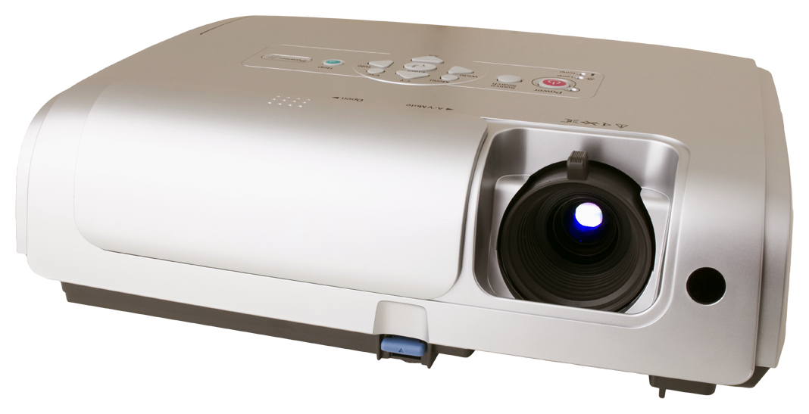
It’s not just what you say, but how you say it
Body language says a lot
Make eye contact with your audience
Corollary: Face your audience
Some movement is good
Don’t speak too fast (or too slow!)
Make useful slides
One primary idea per slide
Use slide titles to convey take-away message
Do not read your slides!
A picture is worth a thousand words…

Slide 23
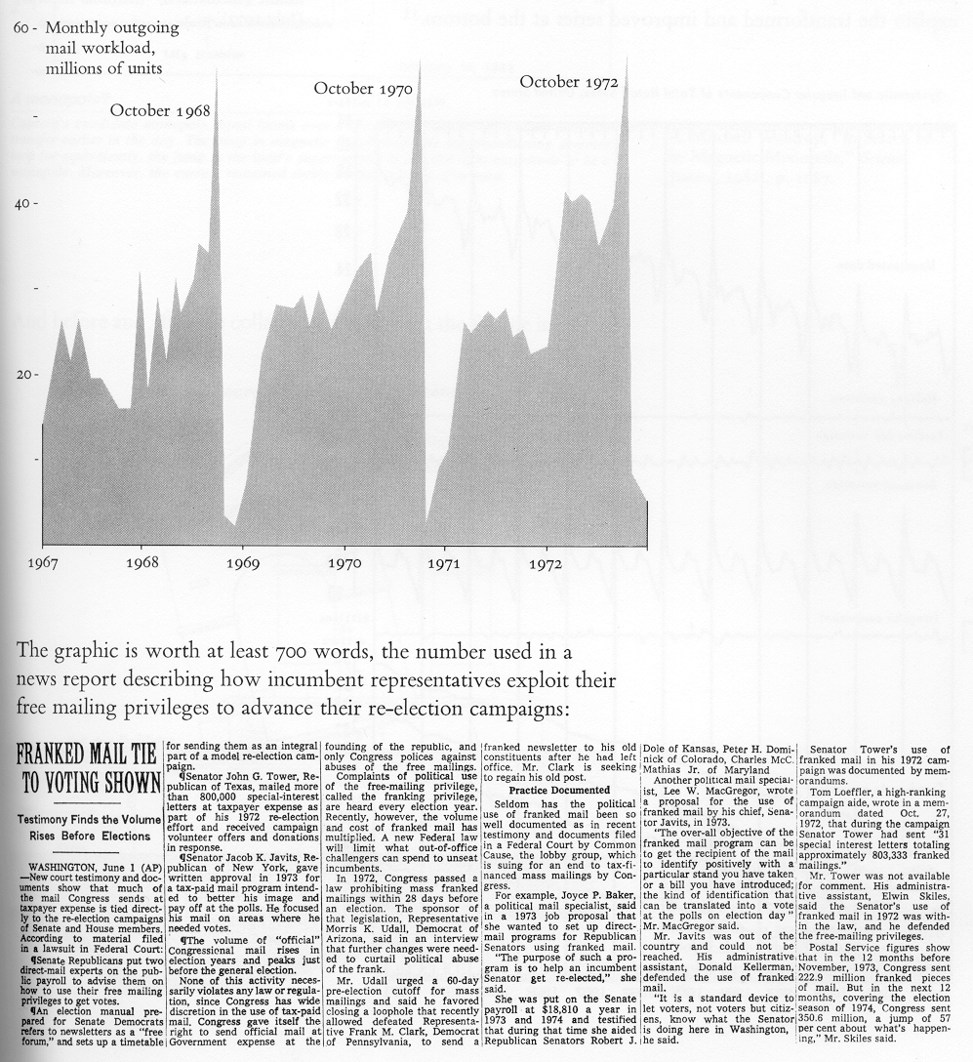
A picture is worth a thousand words
Edward R. Tufte, The Visual Display of Quantitative Information. Graphics Press (2001)
Graphic shows fluctuating mail workload in sync with the timing of political elections

Slide 24
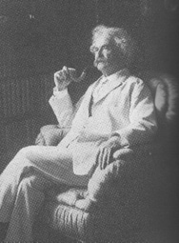
Practice, Practice, Practice
Practice makes better
Alone: Work on your “script,” smooth out transitions
Peer group: Get used to other people being around
Broader population: Assess outsider comprehensibility
“Flash” is good, but too much flash is distracting
Good: Animations to progressively build diagrams
Bad: Animating every slide transition, every line
Make sure you refer to every item on a slide
If you don’t, it is always better to remove that item
It takes three weeks to prepare a good ad-lib speech

